Slide 1
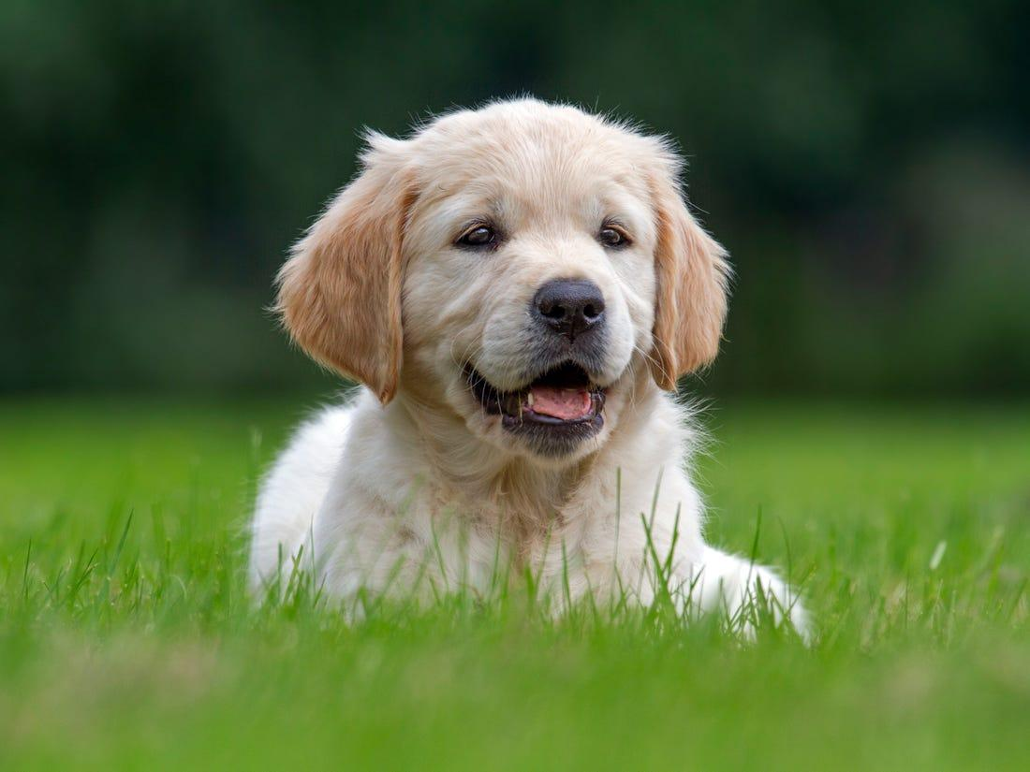
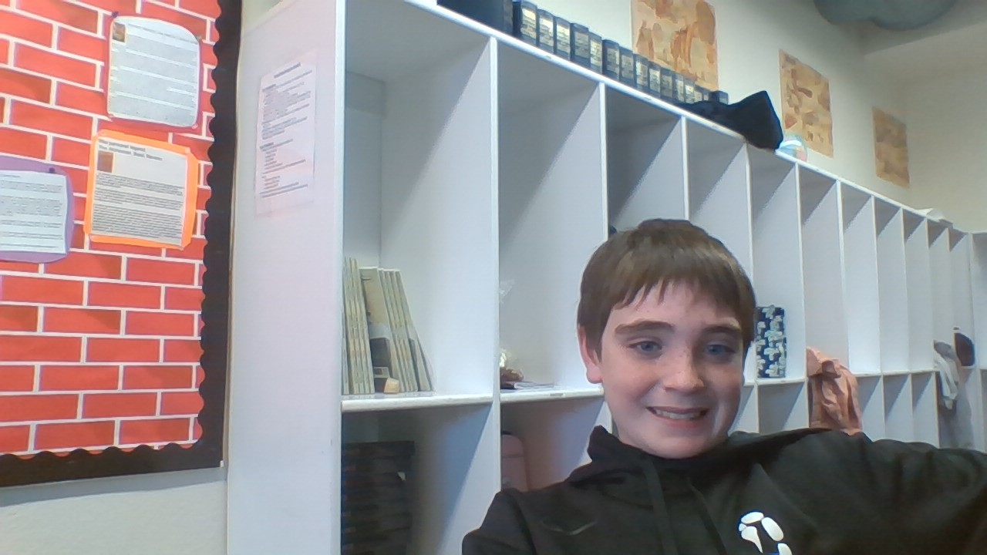
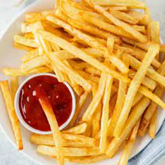
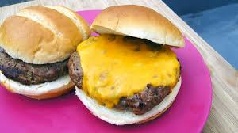
Loz McKenzie
Hi I am very excited to take some things apart this year.
My nickname is Lozzy or Cookie Dough Man
My favorite color is green, I love animals, and I am into technology.

Slide 2
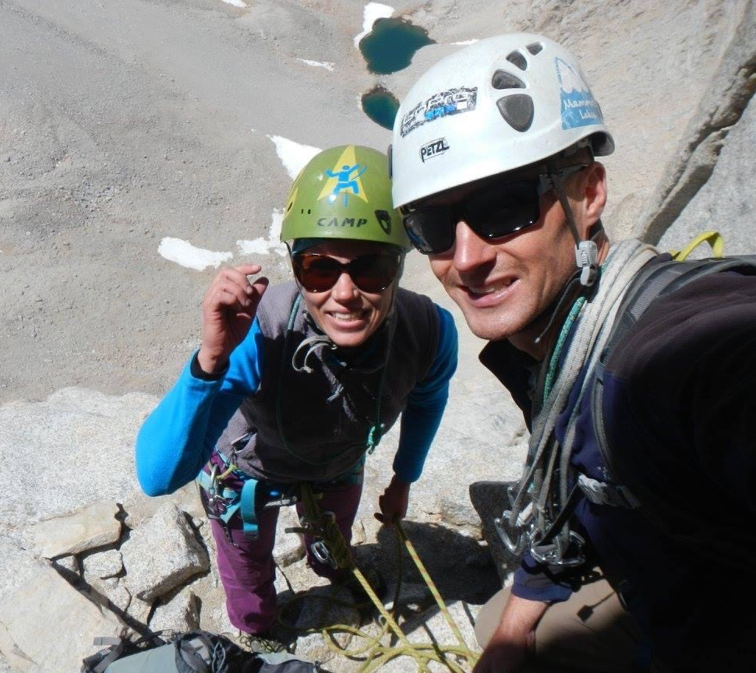
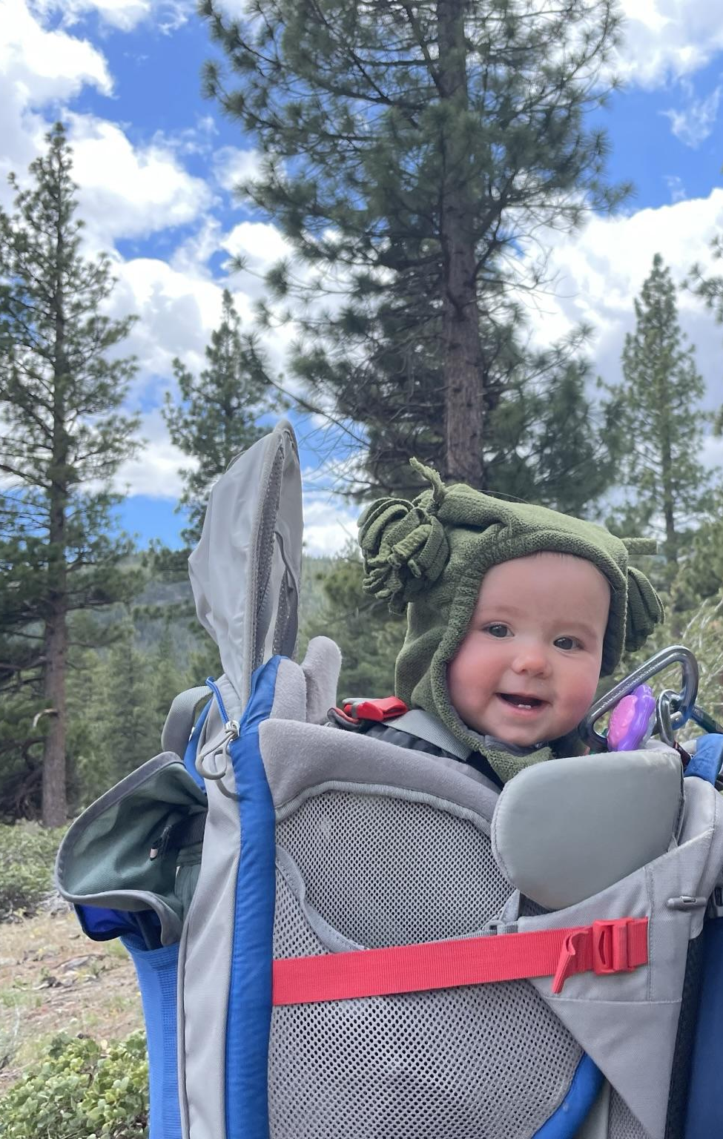
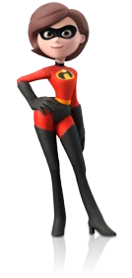
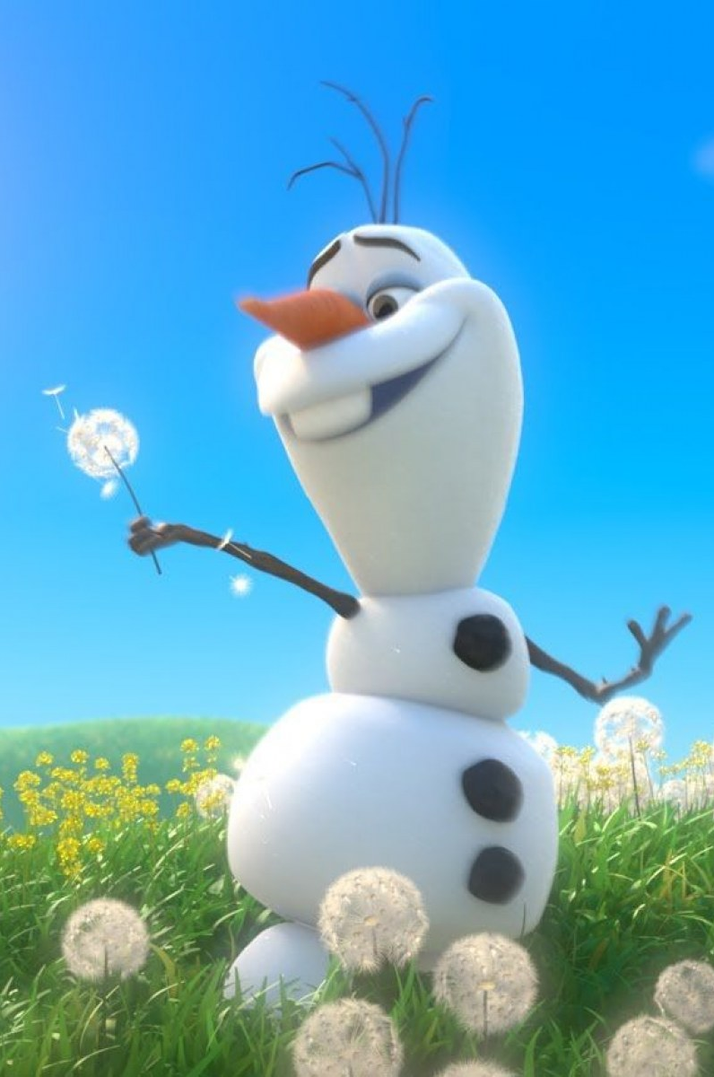
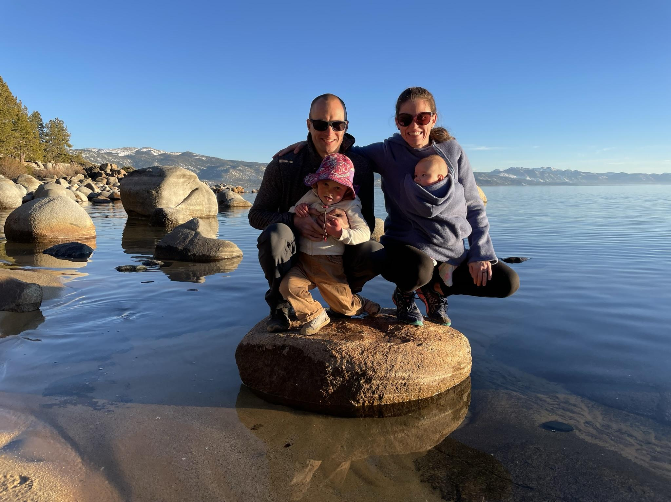
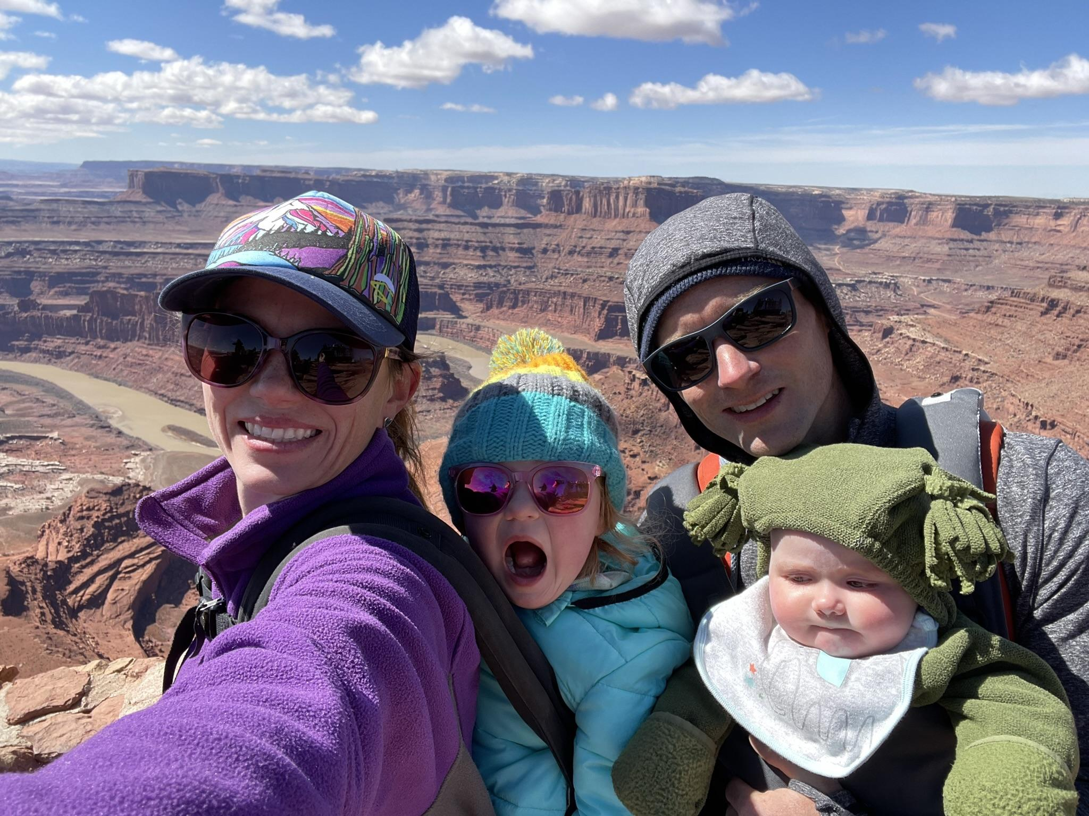
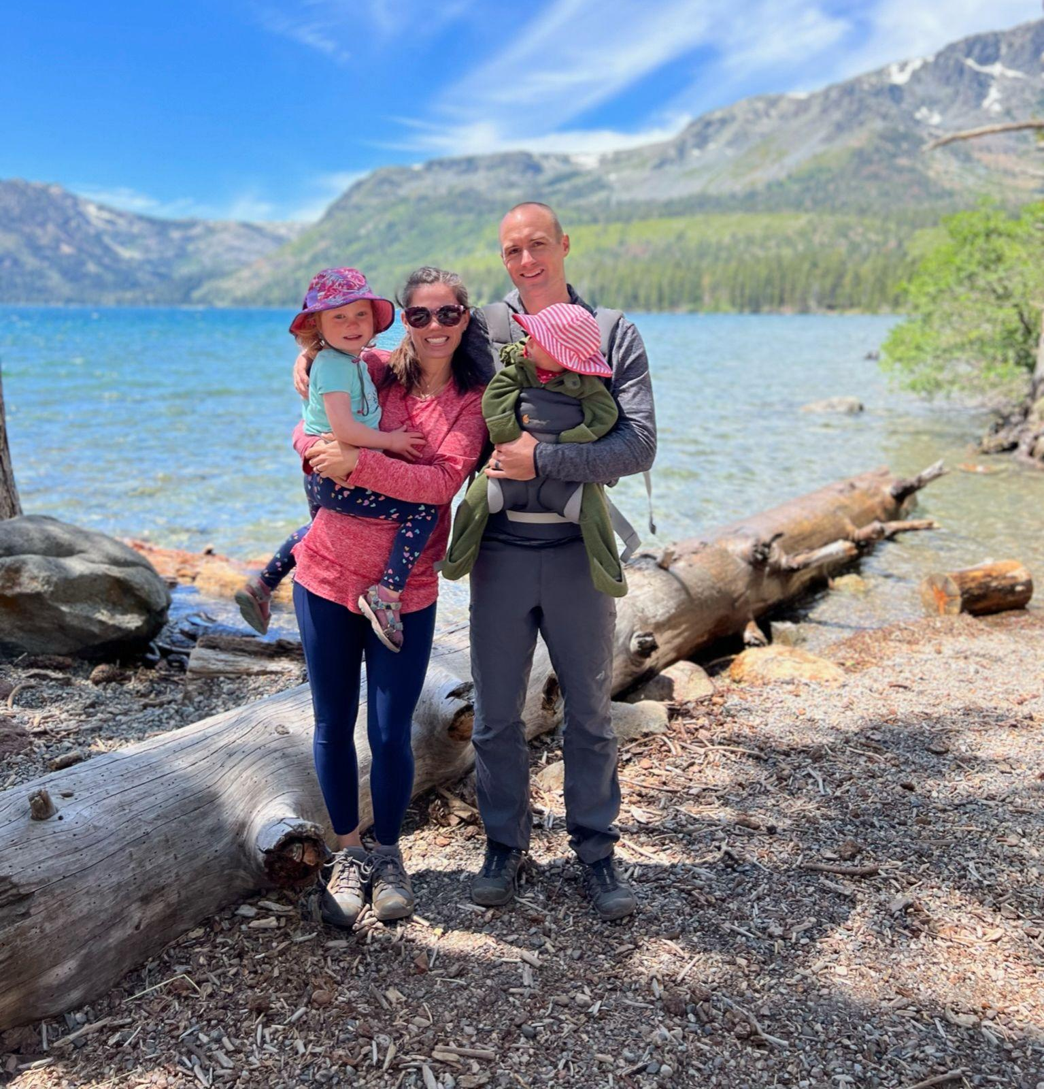
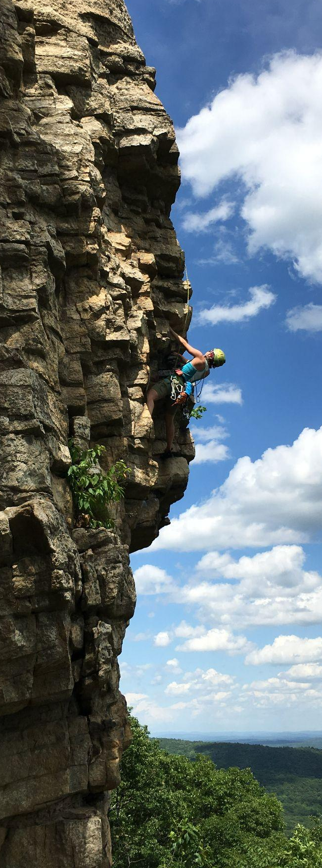

Callie McCartney
Climbing Mt Whitney & Mt Russell
STEM Coordinator and CS Teacher
I’m excited for a new school and for
awesome STEM activities!
Climbing, Biking, Hiking, Playing
Daughters: Emma Rose & Dana Joy
Dead Horse Point NP Moab UT
Fallen Leaf Lake

